Slide 1



Testing of Hypothesis
For Large Samples
DR. HEENA SHARMA
E6398
ASSISTANT PROFESSOR
CSE
DISCOVER . LEARN . EMPOWER

Slide 2
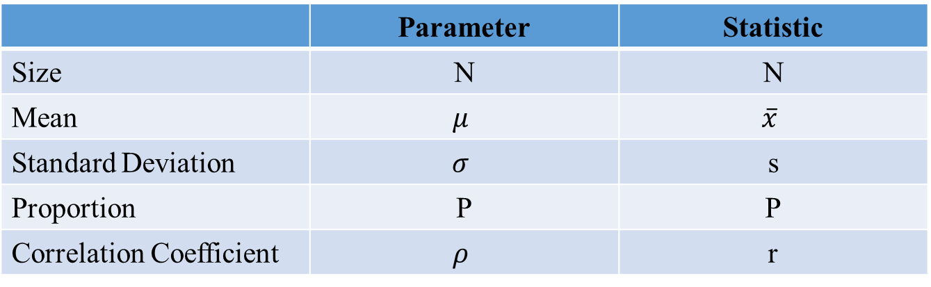
Parameter and Statistics
A measure calculated from population data is called Parameter.
A measure calculated from sample data is called Statistics.
 | Parameter | Statistic
Size | N | N
Mean | $$μ$$ | $$\overline{x}$$
Standard Deviation | $$σ$$ | s
Proportion | P | P
Correlation Coefficient | $$ρ$$ | r

Slide 3

$$Testing of Hypothesis$$
Statistical Hypothesis
A statistical hypothesis is an assumption or any logical statement about the parameter of the population.
E.g.
India will score on an average 300 runs in the next ODI series.
The average marks obtained by students at Chandigarh University in statistics is at least 80.
Proportion of Diabetic Patients in Punjab is not more than 10%.
Students of Chandigarh University score better than students from other universities.

Slide 4
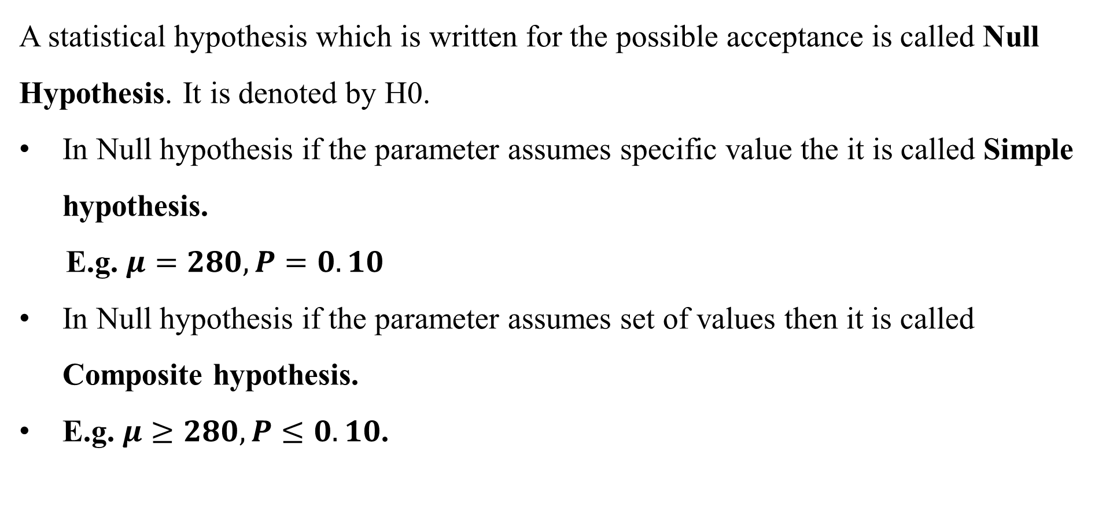
Null Hypothesis
A statistical hypothesis which is written for the possible acceptance is called Null Hypothesis. It is denoted by H0.
In Null hypothesis if the parameter assumes specific value the it is called Simple hypothesis.
E.g. $μ=280, P=0.10$
In Null hypothesis if the parameter assumes set of values then it is called Composite hypothesis.
E.g. $μ≥280, P≤0.10$.

Slide 5
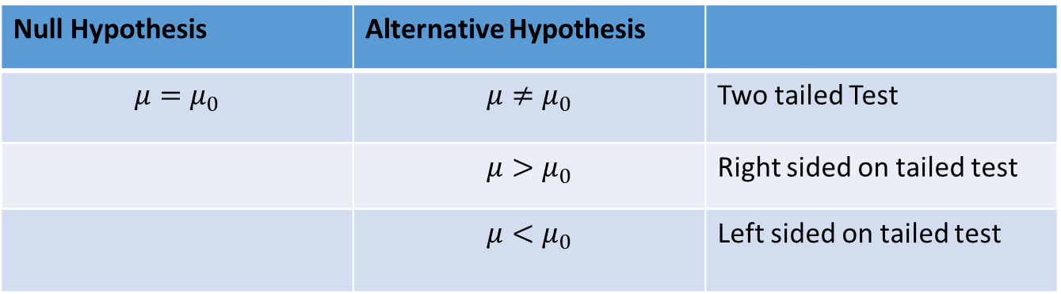
Alternative Hypothesis
A statistical hypothesis which is complementary to the Null hypothesis is called Alternative hypothesis. It is denoted by H1.
Null Hypothesis | Alternative Hypothesis
$$μ=μ_{0}$$ | $$μ≠μ_{0}$$ | Two tailed Test
 | $$μ>μ_{0}$$ | Right sided on tailed test
 | $$μ<μ_{0}$$ | Left sided on tailed test

Slide 6
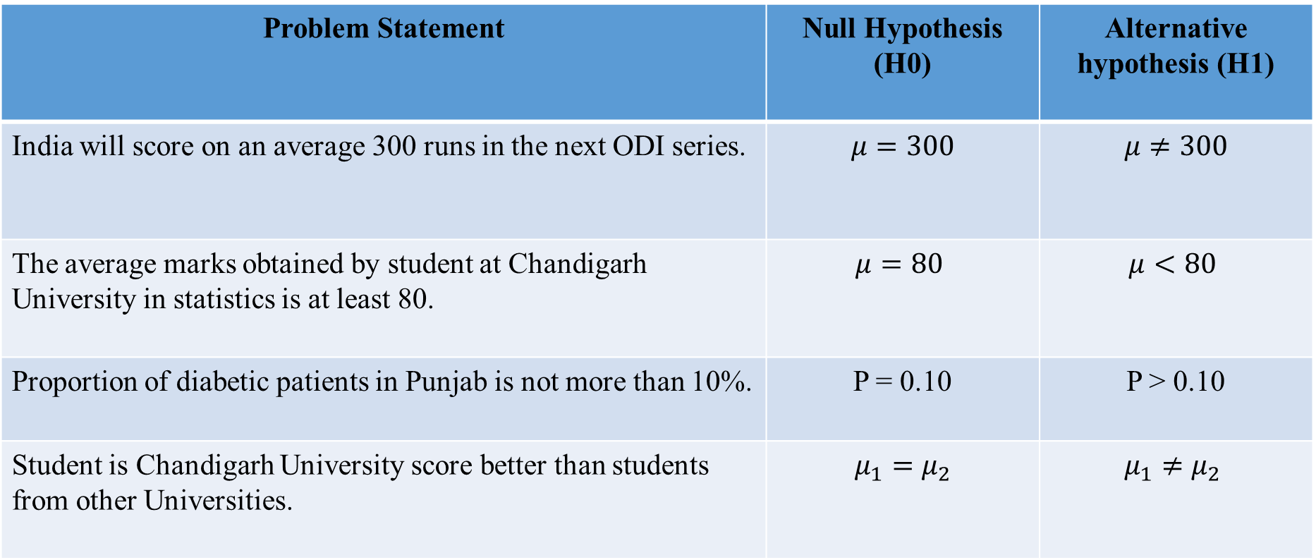
Problem Statement | Null Hypothesis (H0) | Alternative hypothesis (H1)
India will score on an average 300 runs in the next ODI series. | $$μ=300$$ | $$μ≠300$$
The average marks obtained by student at Chandigarh University in statistics is at least 80. | $$μ=80$$ | $$μ<80$$
Proportion of diabetic patients in Punjab is not more than 10%. | P = 0.10 | P > 0.10
Student is Chandigarh University score better than students from other Universities. | $$μ_{1}=μ_{2}$$ | $$μ_{1}≠μ_{2}$$

Slide 7
Testing of Hypothesis
The procedure to decide whether to accept or reject the null hypothesis is called Testing of Hypothesis.
Type-I and Type-II Error
The error of rejecting the true null hypothesis is called Type-I error. The probability of type-I error is denoted by α. α = Prob [Reject H0/H0 is true]
The error of rejecting the false null hypothesis is called Type-II error. The probability of type-I error is denoted by β. β = Prob [Reject H0/H0 is false]

Slide 8
Type-I and Type-II Error
Decision | Null Hypothesis
 | True | False
Accept | No Error | Type-II Error
Reject | Type-I Error | No Error

Slide 9
Level of Significance
The predetermined value of Probability of type-I error is called level of significance. It is denoted by α.
The most commonly used level of significance are 1% or 5%.
Interpretation: 5% level of significance means in 5 out of 100 cases, it is likely to reject a true null hypothesis.

Slide 10
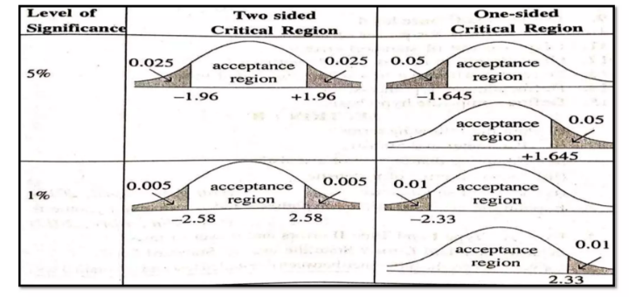
Critical Region
The area of probability curve corresponding to α is called critical region.
i.e. the area under normal curve at which a true null hypothesis is rejected is called area of rejection or critical region.
The remaining region under normal curve is called acceptance region.

Slide 11
Power of Test
The probability of rejecting the false null hypothesis is called the Power of the test.
It is denoted by 1- β.
i.e. 1- β = Prob [Reject H0/H0 is false]

Slide 12
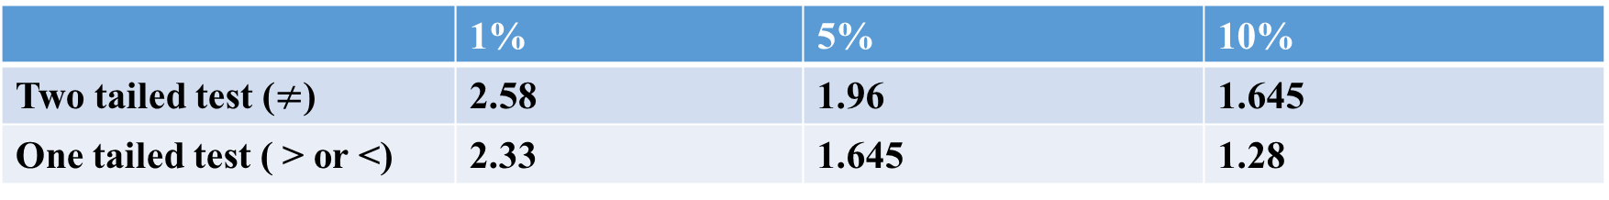
Test Statistics
If the sample size is more than or equal to 30, it is called a large sample and if it is less than 30, it is called a small sample.
For a large sample, test statistic z is used.
For a small sample, test statistic t is used.
Z-Table Value
 | 1% | 5% | 10%
Two tailed test ($≠$) | 2.58 | 1.96 | 1.645
One tailed test ( > or <) | 2.33 | 1.645 | 1.28

Slide 13
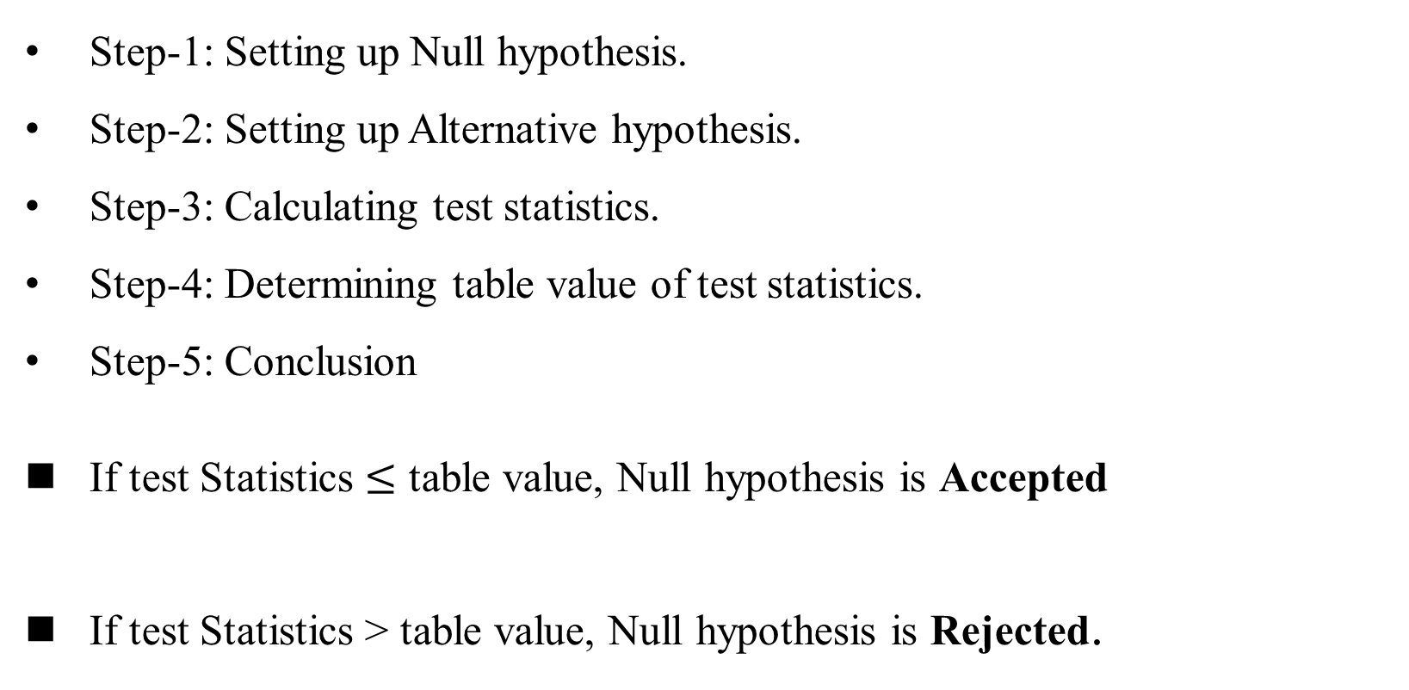
Steps of Testing of Hypothesis
Step-1: Setting up Null hypothesis.
Step-2: Setting up Alternative hypothesis.
Step-3: Calculating test statistics.
Step-4: Determining table value of test statistics.
Step-5: Conclusion
If test Statistics $≤$ table value, Null hypothesis is Accepted
If test Statistics > table value, Null hypothesis is Rejected.

Slide 14
Large Sample Test
Test of Single Mean
Test of Significance of difference between two means.
Test of Significance of difference between two standard deviation
Test of Single Proportion
Test of significance of difference between two proportions.

Slide 15
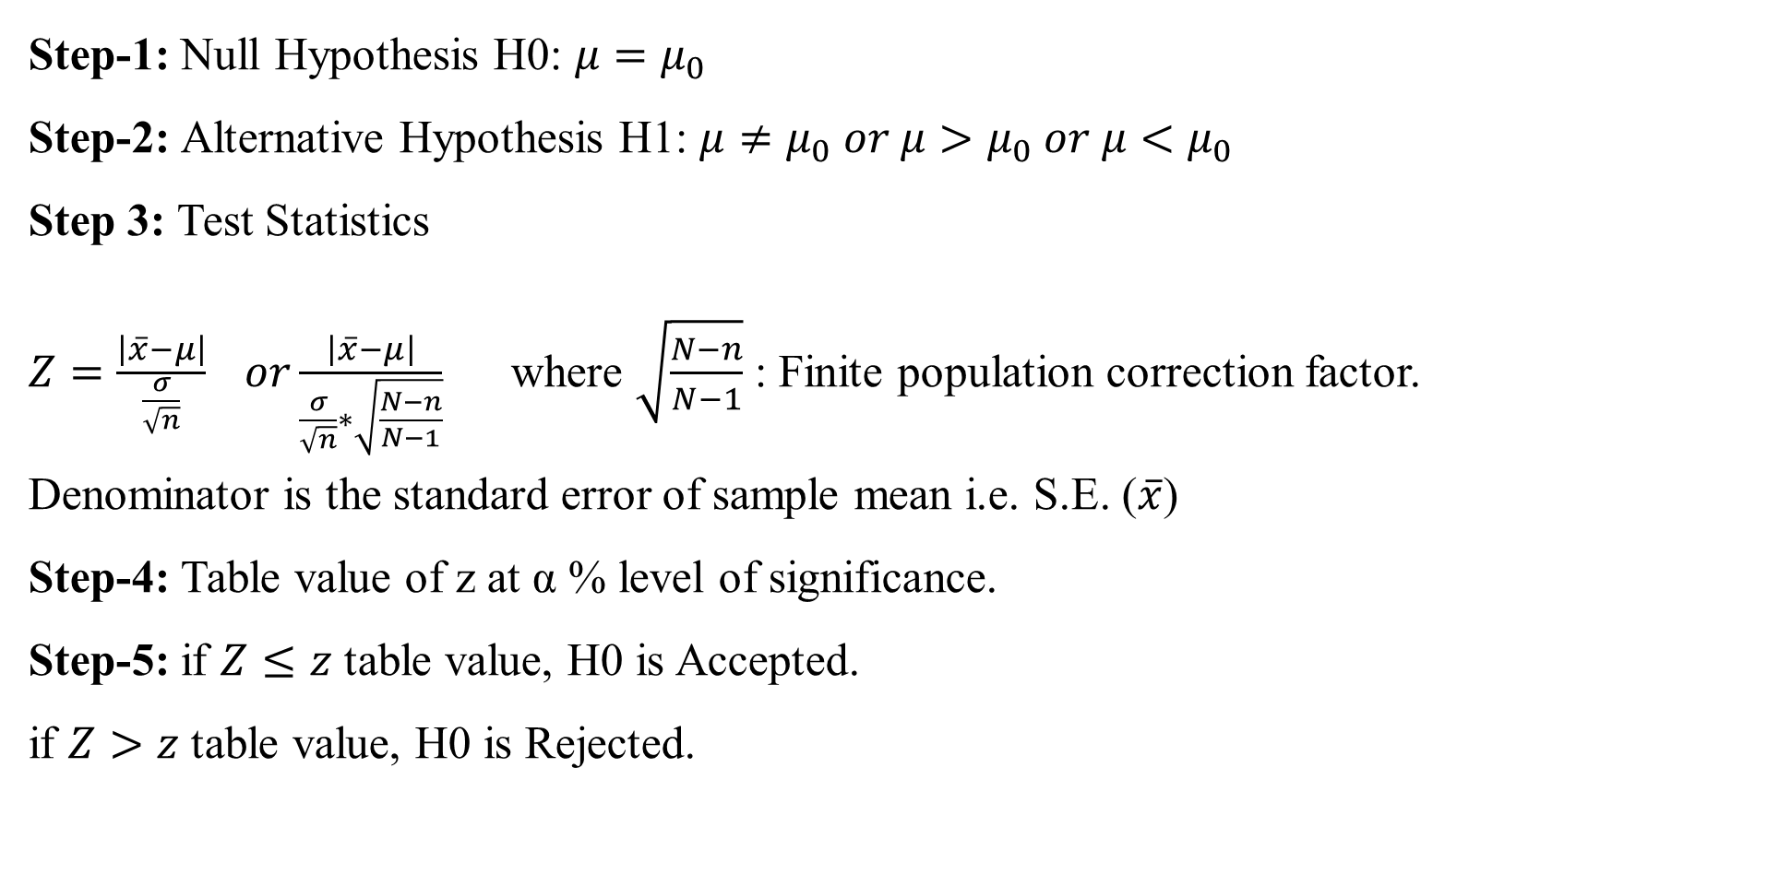
Test-1 Test of Single Mean
Step-1: Null Hypothesis H0: $μ=μ_{0}$
Step-2: Alternative Hypothesis H1: $μ≠μ_{0} or μ>μ_{0} or μ<μ_{0}$
Step 3: Test Statistics
$Z=\frac{\left|\overline{x}−μ\right|}{\frac{σ}{\sqrt{n}}} or\frac{\left|\overline{x}−μ\right|}{\frac{σ}{\sqrt{n}}∗\sqrt{\frac{N−n}{N−1}}}$ where $\sqrt{\frac{N−n}{N−1}}$ : Finite population correction factor.
Denominator is the standard error of sample mean i.e. S.E. ($\overline{x}$)
Step-4: Table value of z at α % level of significance.
Step-5: if $Z≤z$ table value, H0 is Accepted.
if $Z>z$ table value, H0 is Rejected.

Slide 16
Case Study 1
It is hoped that a newly developed pain reliever will more quickly produce perceptible reduction in pain to patients after minor surgeries than a standard pain reliever.
The standard pain reliever is known to bring relief in an average of 3.5 minutes with standard deviation 2.1 minutes. To test whether the new pain reliever works more quickly than the standard one, 50 patients with minor surgeries were given the new pain reliever and their times to relief were recorded. The experiment yielded sample mean is 3.1 minutes and sample standard deviation is 1.5 minutes. Is there sufficient evidence in the sample to indicate, at the 5% level of significance, that the newly developed pain reliever does deliver perceptible relief more quicky?

Slide 17
Case Study 2
A cosmetics company fills its best selling 8-ounce jars of facial cream by an automatic dispensing machine.
The machine is set to dispense a mean of 8.1 ounces per jar. Uncontrollable n the process can shift the mean away from 8.1 and cause either underfill or overfill, both of which are undesirable. In such a case the dispensing machine is stopped and recalibrated. Regardless of the mean amount dispensed, the standard deviation of the amount dispensed always has value 0.22 ounce. A quality control engineer routinely selects 30 jars from the assembly line to check the amounts filled. On one occasion, the sample mean is 8.2 ounces and the sample standard deviation is 0.25 ounce. Determine if there is sufficient evidence in the sample to indicate, at the 1% level of significance, that the machine should be recalibrated.

Slide 18
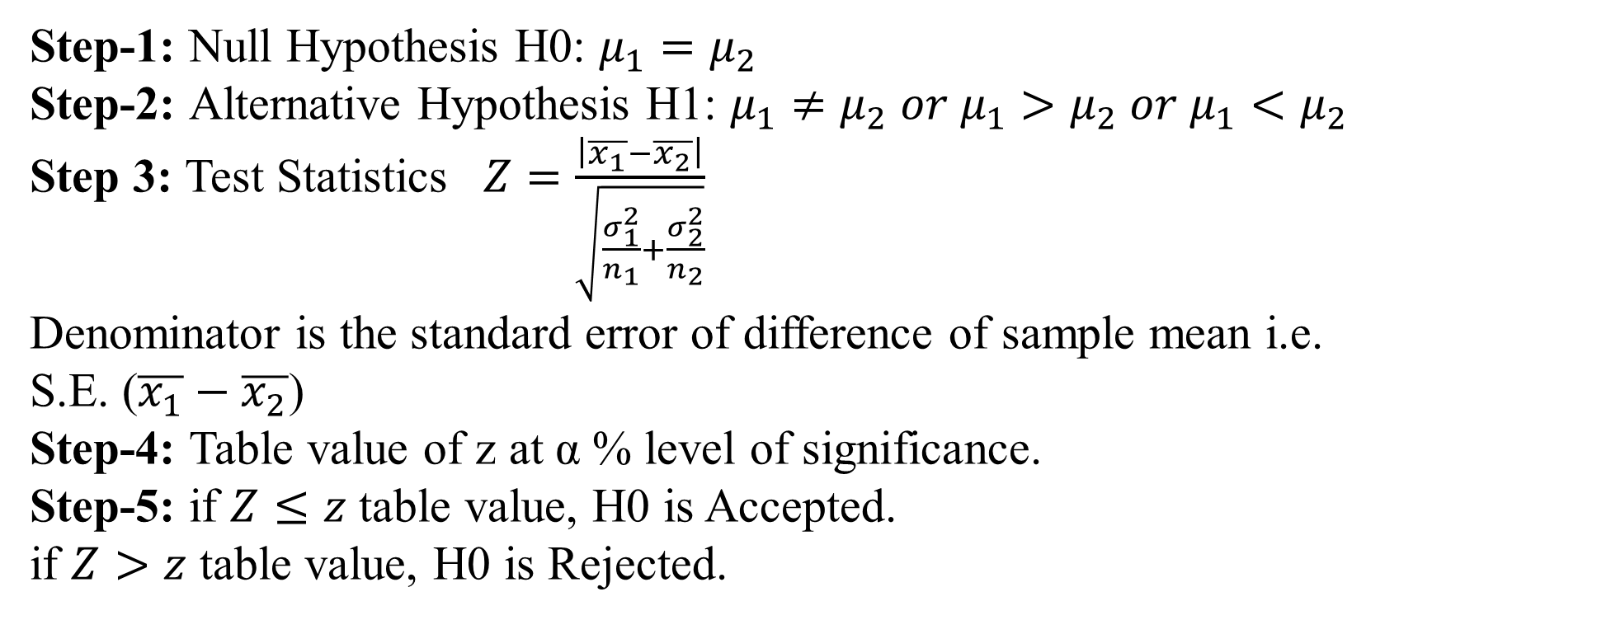
Test 2: Test of significance of difference between two means
Step-1: Null Hypothesis H0: $μ_{1}=μ_{2}$
Step-2: Alternative Hypothesis H1: $μ_{1}≠μ_{2} or μ_{1}>μ_{2} or μ_{1}<μ_{2}$
Step 3: Test Statistics $Z=\frac{\left|\overline{x_{1}}−\overline{x_{2}}\right|}{\sqrt{\frac{σ_{1}^{2}}{n_{1}}+\frac{σ_{2}^{2}}{n_{2}}}}$
Denominator is the standard error of difference of sample mean i.e.
S.E. ($\overline{x_{1}}−\overline{x_{2}}$)
Step-4: Table value of z at α % level of significance.
Step-5: if $Z≤z$ table value, H0 is Accepted.
if $Z>z$ table value, H0 is Rejected.

Slide 19
Case Study 1
A nutritionist is interested in whether two proposed diets, Diet A and Diet B work equally well in providing weight-loss for customers.
In order to assess a difference between the two diets, she puts 50 customers on Diet A and 60 other customers on the diet B for two weeks. Those on the former had weight losses with an average of 11 pounds and a standard deviation pf 3 pounds, while those on the latter lost an average of 8 pounds with a standard deviation of 2 pounds. Do the diets differ in terms of their weight loss?

Slide 20
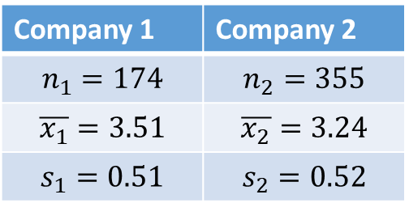
Case Study 2
To compare customer satisfaction levels of two competing cable television companies, 174 customers of company 1 and 355 customers of company 2 were randomly selected and were asked to rate their cable companies on a five-point scale, with 1 being least satisfied and 5 most satisfied. The survey results are summarized in the following table:
Test at the 1% level of significance whether the data provide sufficient evidence to conclude that company 1 has a higher mean satisfaction rating than does company 2.
Company 1 | Company 2
$$n_{1}=174$$ | $$n_{2}=355$$
$$\overline{x_{1}}=3.51$$ | $$\overline{x_{2}}=3.24$$
$$s_{1}=0.51$$ | $$s_{2}=0.52$$

Slide 21
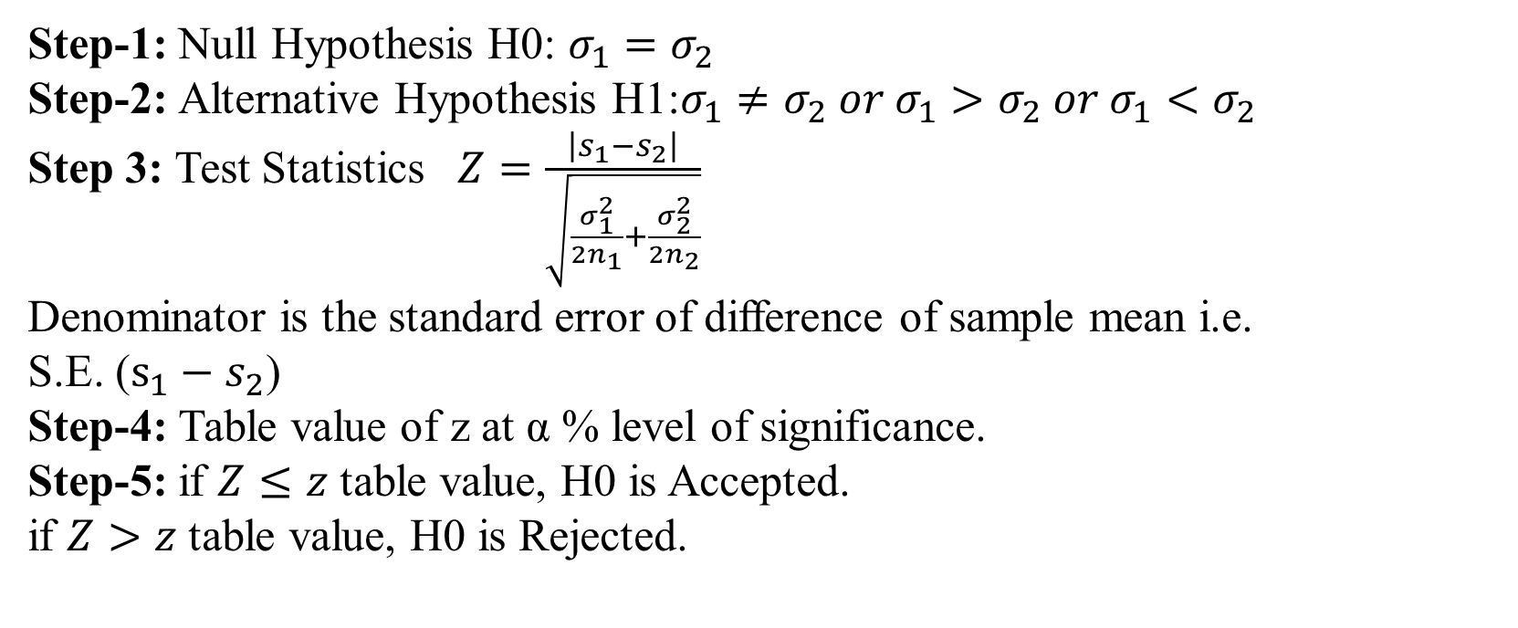
Test 3: Test of significance of difference between two standard deviations
Step-1: Null Hypothesis H0: $σ_{1}=σ_{2}$
Step-2: Alternative Hypothesis H1:$σ_{1}≠σ_{2} or σ_{1}>σ_{2} or σ_{1}<σ_{2}$
Step 3: Test Statistics $Z=\frac{\left|s_{1}−s_{2}\right|}{\sqrt{\frac{σ_{1}^{2}}{{2n}_{1}}+\frac{σ_{2}^{2}}{2n_{2}}}}$
Denominator is the standard error of difference of sample mean i.e.
S.E. ($s_{1}−s_{2}$)
Step-4: Table value of z at α % level of significance.
Step-5: if $Z≤z$ table value, H0 is Accepted.
if $Z>z$ table value, H0 is Rejected.

Slide 22
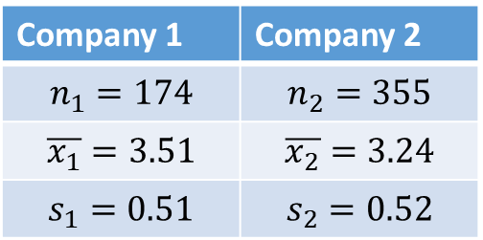
Case Study
To compare customer satisfaction levels of two competing cable television companies, 174 customers of company 1 and 355 customers of company 2 were randomly selected and were asked to rate their cable companies on a five-point scale, with 1 being least satisfied and 5 most satisfied. The survey results are summarized in the following table:
Company 1 | Company 2
$$n_{1}=174$$ | $$n_{2}=355$$
$$\overline{x_{1}}=3.51$$ | $$\overline{x_{2}}=3.24$$
$$s_{1}=0.51$$ | $$s_{2}=0.52$$
Test at the 1% level of significance whether the data provide sufficient evidence to conclude that there is significant difference in standard deviation of company 1 and company 2.

Slide 23
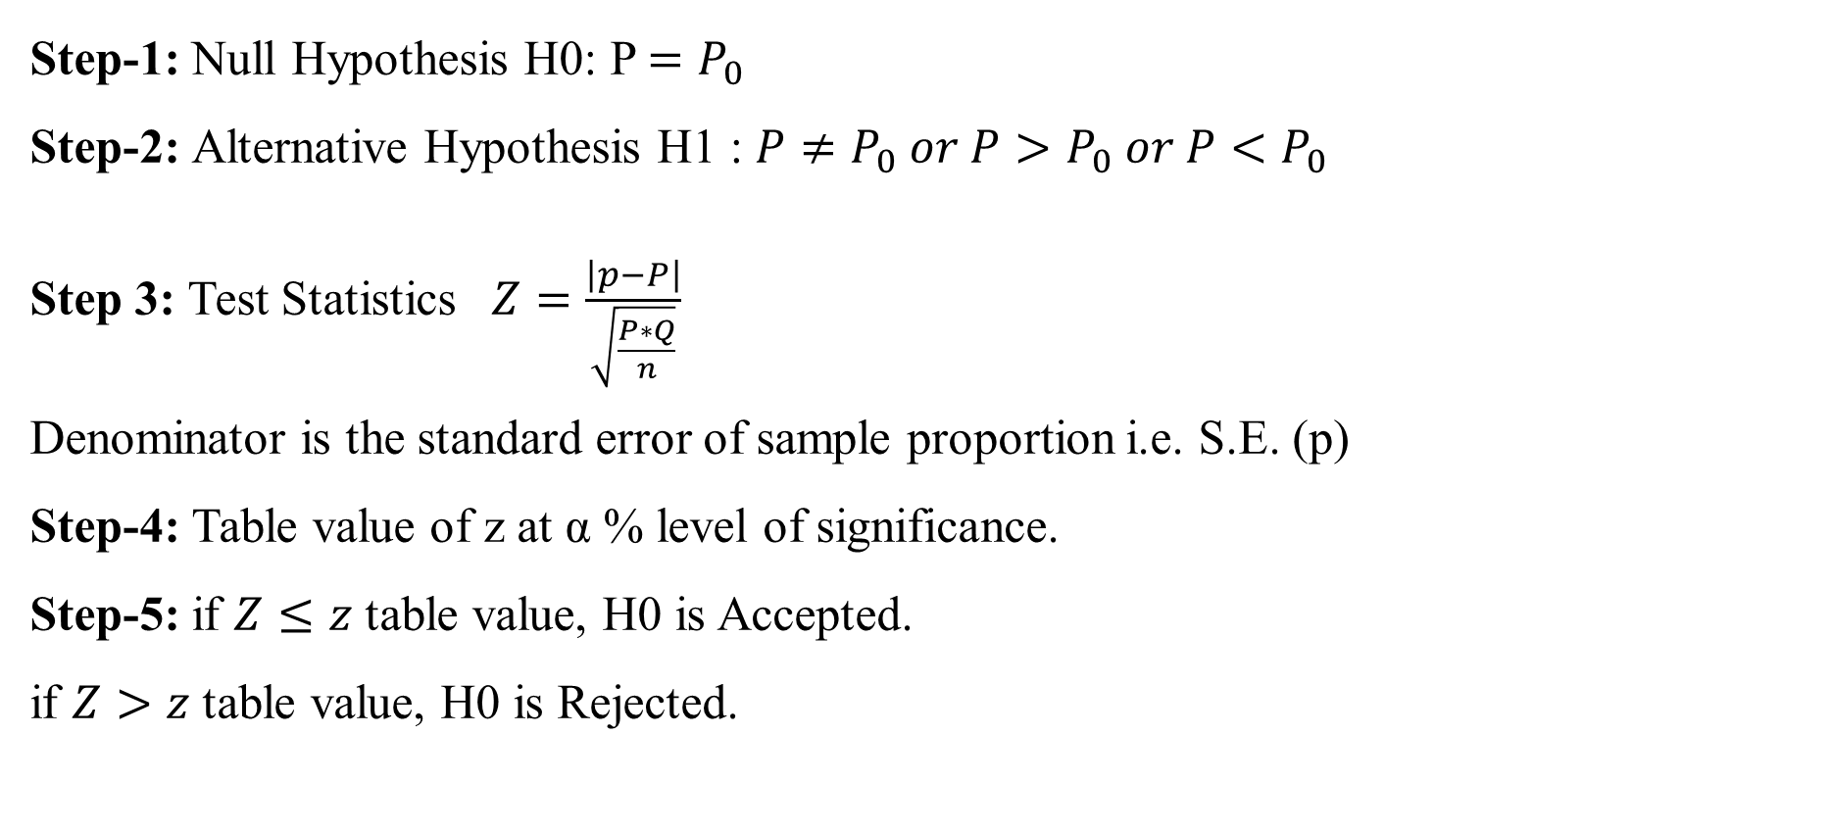
Test 4: Test of Single Proportion
Step-1: Null Hypothesis H0: P $=P_{0}$
Step-2: Alternative Hypothesis H1 : $P≠P_{0} or P>P_{0} or P<P_{0}$
Step 3: Test Statistics $Z=\frac{\left|p−P\right|}{\sqrt{\frac{P∗Q}{n}}}$
Denominator is the standard error of sample proportion i.e. S.E. (p)
Step-4: Table value of z at α % level of significance.
Step-5: if $Z≤z$ table value, H0 is Accepted.
if $Z>z$ table value, H0 is Rejected.

Slide 24
Case Study 1
Globally the long term proportion of new-borns who are male is 51.46%. A researcher believes that the proportion of boys at birth changes under severe economic conditions. To test this belief randomly selected birth records of 5, 000 babies born during a period of economic recession were examined. It was found in the sample that 52.55% of the new-borns were boys.
Determine whether there is sufficient evidence, at the 10% level of significance, to support the researcher’s belief.

Slide 25
Case Study 2
A soft drink maker claims that a majority of adults prefer its leading beverage over that of its man competitor’s. To test this claim 500 randomly selected people were given the two beverages in random order to taste. Among then, 270 preferred the soft drink maker’s brand, 211 preferred the competitor’s brand, and 19 could not make up their minds.
Determine whether there is sufficient evidence, at the 5% level of significance, to support the soft drink make’s claim against the default that the population is evenly split in its preference.

Slide 26
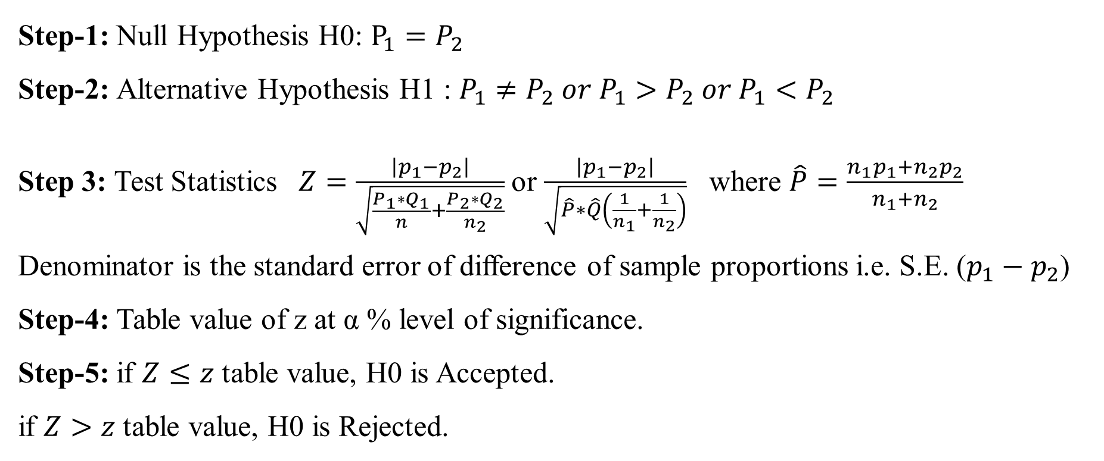
Test 5: Test of significance of difference between two proportions
Step-1: Null Hypothesis H0: $P_{1}=P_{2}$
Step-2: Alternative Hypothesis H1 : $P_{1}≠P_{2} or P_{1}>P_{2} or P_{1}<P_{2}$
Step 3: Test Statistics $Z=\frac{\left|p_{1}−p_{2}\right|}{\sqrt{\frac{P_{1}∗Q_{1}}{n}+\frac{P_{2}∗Q_{2}}{n_{2}}}}$ or $\frac{\left|p_{1}−p_{2}\right|}{\sqrt{\hat{P}∗\hat{Q}\left(\frac{1}{n_{1}}+\frac{1}{n_{2}}\right)}}$ where $\hat{P}=\frac{n_{1}p_{1}+n_{2}p_{2}}{n_{1}+n_{2}}$
Denominator is the standard error of difference of sample proportions i.e. S.E. ($p_{1}−p_{2}$)
Step-4: Table value of z at α % level of significance.
Step-5: if $Z≤z$ table value, H0 is Accepted.
if $Z>z$ table value, H0 is Rejected.

Slide 27
Case Study 1
Volters in a particular city who identify themselves with one or the other of two political parties were randomly selected and asked if they favour a proposal to remove article 370 from Kashmir. The results are:
 | Part A | Part B
Sample Size | 150 | 200
No. in favour | 90 | 140
Test, at the 5% level of significance, the hypothesis that the proportion of members of party A who favour the proposal is less than the proportion of members of party B who do.

Slide 28
Case Study 2
Suppose the Acme Drug company develops a new drug, designed to prevent colds. The company states that the drug is equally effective for men and women. To test this claim, they choose a simple random sample of 100 women and 200 men who were suffering from cold.
At the end of the study, 38% of the women were cured from cold; and 51% of the men were cured from cold. Based on these findings, can we reject the company’s claim that the drug is equally effective for men and women? Use a 0.05 level of significance.

Slide 29
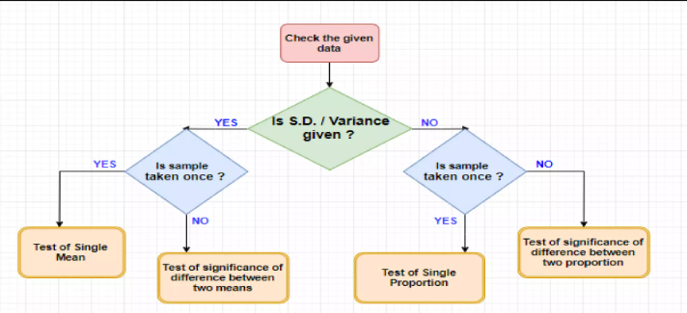
Flow chart for selecting Test

Slide 30
THANKS FOR PAYING ATTENTION
Please Send Your Queries on:
e-Mail: heena.e6398@cumail.in

